Slide 1

Digital Portfolio
STUDENT NAME: kirsh S
REGISTER NO AND NMID: 2426j0094.asbruap2426j0094 DEPARTMENT: Information Technology COLLEGE: PPG Collage of Arts and Science,Bharathiar university
1

Slide 2

PROJECT TITLE
SIMPLE PORTFOLIO
2

Slide 3



AGENDA
1.Problem Statement 2.Project Overview 3.End Users 4.Tools and Technologies 5.Portfolio design and Layout 6.Features and Functionality 7.Results and Screenshots 8. Conclusion 9.Github Link
3/21/2024 Annual Review
3

Slide 4


Problem Statement
Many students and professionals need a simple, clean online presence to showcase their skills, projects, and contact information. The challenge is to create a lightweight, easy-to- maintain portfolio website that highlights the developer’s background and work using basic web technologies.
4

Slide 5

PROJECT OVERVIEW
The goal of this project is to build a personal portfolio website for kirsh s, a B.Sc. Computer Science student. The website will display kirsh 's background, skills, and projects and provide a contact form for visitors to reach out. The project uses only HTML, CSS, and JavaScript to create a responsive, user-friendly site.
5

Slide 6
WHO ARE THE END USERS?
End Users Potential employers or recruiters looking for kirsh’s skills and projects. Friends, classmates, or professional contacts who want to learn more about kirsh’s work. Anyone interested in web development who might benefit from seeing a simple portfolio example.
6

Slide 7

TOOLS AND TECHNIQUES
Tools and Technologies HTML: To structure the content of the website. CSS: For styling and layout, ensuring the site looks clean and professional. JavaScript: To add interactivity, such as form validation and user feedback. Browser: To view and test the website locally. Text Editor (like VS Code, Sublime Text): To write and edit code.
7

Slide 8

POTFOLIO DESIGN AND LAYOUT
Portfolio Design and Layout Header: Contains kirsh’s name, degree, and navigation menu linking to sections (About, Projects, Contact).
About Section: Brief introduction about kirsh and his passion for web development.
Projects Section: A showcase of simple projects to demonstrate coding skills.
Contact Section: A form where visitors can send messages directly (with basic validation).
Footer: Displays copyright info.
Responsive Layout: The site is centered with a max-width to keep content readable and spaced well.
Color Scheme: Dark header/footer with light content area for contrast and readability.
Clean and Minimalist: Focus on content without distractions.
8

Slide 9
FEATURES AND FUNCTIONALITY
Features andFunctionality
Navigation Menu: Smoothand easyto access sections ofthepage.
About Me Section: Static text introducing kirsh.
Projects Section: Lists multiple projects with titles and descriptions.
Contact Form: Input fields for name, email, and message. Validation to ensure all fields are filled before submitting. JavaScript alert confirms successful message submission. Form resets after submission.
Responsive Design: Works well on desktop and smaller screens.
Consistent Styling: Uses CSS for layout, colors, fonts, and hover effects on buttons. User Feedback: Alerts provide simple interaction feedback.

Slide 10
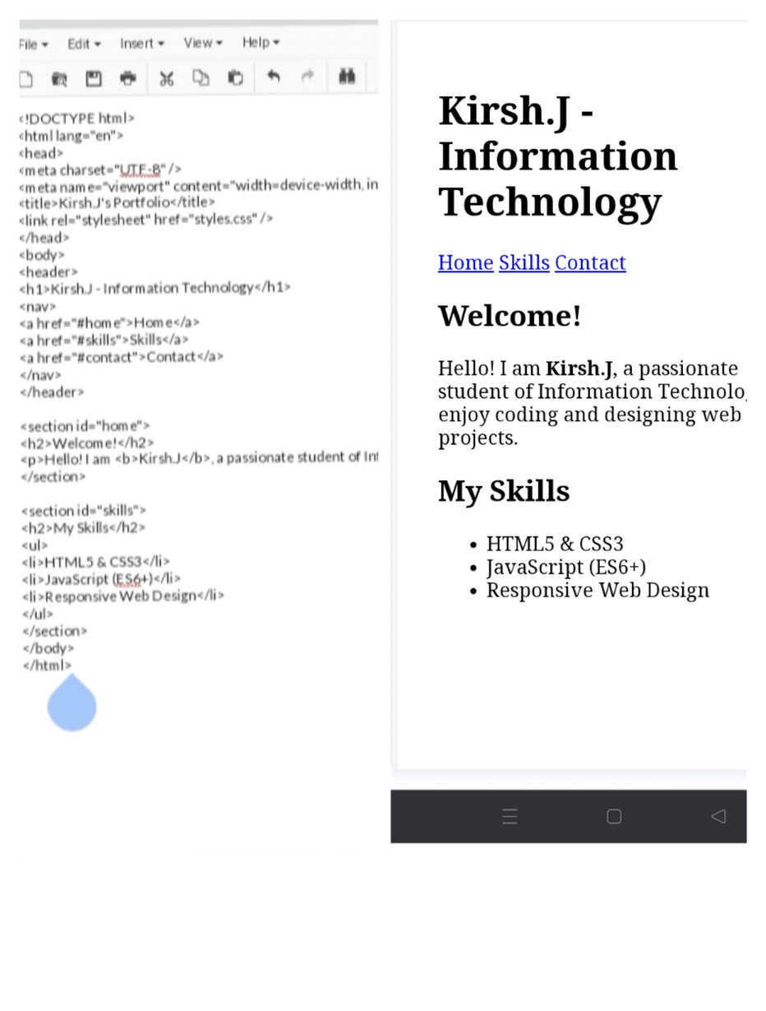

RESULTS AND SCREENSHOTS
3/21/2024 Annual Review
10

Slide 11
CONCLUSION
This portfolio website project successfully demonstrates the ability to build a clean, responsive, and functional personal website using only HTML, CSS, and JavaScript. It provides a solid foundation for showcasing skills and projects for potential employers or contacts.
11

